Slide 1
Code Demo - Pixel Art
Roman Gerloff

Slide 2

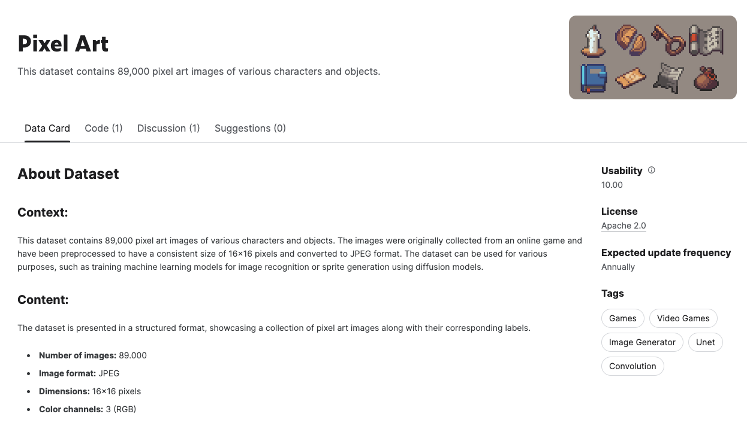


Dataset

Slide 3
Overview
create_new_folder() -> None
load_data() -> np.array
create_generator() -> Sequential
create_discriminator() -> Sequential
discriminator_loss() -> float
generator_loss() -> float
train_step() -> tuple
train() -> tuple
generate_and_save_images() -> None
plot_losses() -> None

Slide 4
Overview
create_new_folder() -> None
load_data() -> np.array
create_generator() -> Sequential
create_discriminator() -> Sequential
discriminator_loss() -> float
generator_loss() -> float
train_step() -> tuple
train() -> tuple
generate_and_save_images() -> None
plot_losses() -> None

Slide 5
Overview
create_new_folder() -> None
load_data() -> np.array
create_generator() -> Sequential
create_discriminator() -> Sequential
discriminator_loss() -> float
generator_loss() -> float
train_step() -> tuple
train() -> tuple
generate_and_save_images() -> None
plot_losses() -> None

Slide 6
Overview
create_new_folder() -> None
load_data() -> np.array
create_generator() -> Sequential
create_discriminator() -> Sequential
discriminator_loss() -> float
generator_loss() -> float
train_step() -> tuple
train() -> tuple
generate_and_save_images() -> None
plot_losses() -> None

Slide 7
Overview
create_new_folder() -> None
load_data() -> np.array
create_generator() -> Sequential
create_discriminator() -> Sequential
discriminator_loss() -> float
generator_loss() -> float
train_step() -> tuple
train() -> tuple
generate_and_save_images() -> None
plot_losses() -> None

Slide 8
import os
from datetime import datetime
import imageio
import numpy as np
from tqdm import tqdm
import tensorflow as tf
import matplotlib.pyplot as plt
from keras.api.models import Sequential
from keras.api.losses import BinaryCrossentropy
from keras.api.optimizers import Adam
from keras.api.layers import (
Input,
Dense,
LeakyReLU,
Reshape,
Conv2D,
Conv2DTranspose,
BatchNormalization,
LeakyReLU,
Flatten,
)

Slide 9
Warnings and GPU
os.environ["TF_CPP_MIN_LOG_LEVEL"] = "3"
physical_devices = tf.config.list_physical_devices("GPU")
tf.config.experimental.set_memory_growth(physical_devices[0], True)

Slide 10
Constants
IMG_DIR = "data"
GRID_SIZE = (5, 5)
IMG_SHAPE = (16, 16, 3) NOISE_LENGTH = 100
BATCH_SIZE = 128 # or 64 EPOCHS = 30 # or 50
LEARNING_RATE = 1e-4

Slide 11
def create_new_folder() -> str:
current_datetime = datetime.now().strftime("%Y-%m-%d %H-%M-%S")
path_run = f"images/{current_datetime}"
os.makedirs(path_run, exist_ok=True)
return path_run
path_run = create_new_folder()

Slide 12
def load_data() -> np.array:
global IMG_DIR
img_files = [os.path.join(IMG_DIR, f) for f in os.listdir(IMG_DIR)]
images = [
tf.image.decode_image(tf.io.read_file(file), channels=3).numpy()
for file in img_files
]
train_images = np.array(images)
train_images = (train_images - 127.5) / 127.5
return train_images
train_images = load_data()

Slide 13
def load_data() -> np.array:
global IMG_DIR
img_files = [os.path.join(IMG_DIR, f) for f in os.listdir(IMG_DIR)]
images = [
tf.image.decode_image(tf.io.read_file(file), channels=3).numpy()
for file in img_files
]
train_images = np.array(images)
train_images = (train_images - 127.5) / 127.5
return train_images
train_images = load_data()

Slide 14
def load_data() -> np.array:
global IMG_DIR
img_files = [os.path.join(IMG_DIR, f) for f in os.listdir(IMG_DIR)]
images = [
tf.image.decode_image(tf.io.read_file(file), channels=3).numpy()
for file in img_files
]
train_images = np.array(images)
train_images = (train_images - 127.5) / 127.5
return train_images
train_images = load_data()

Slide 15
train_images = load_data()

Slide 16
Images
train_images = load_data()

Slide 17
Images
train_images = load_data()
train_images.shape
> (89400, 16, 16, 3)

Slide 18
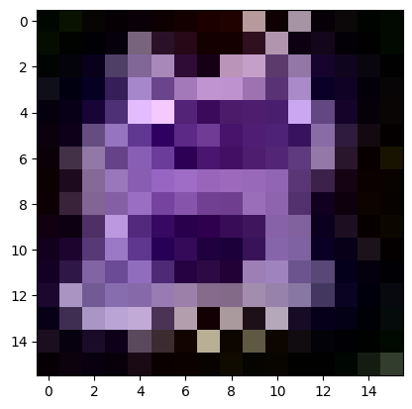
Images
train_images = load_data()
train_images.shape
> (89400, 16, 16, 3)
plt.imshow((train_images[0] * 127.5 + 127.5).astype(np.uint8))
plt.show()

Slide 19
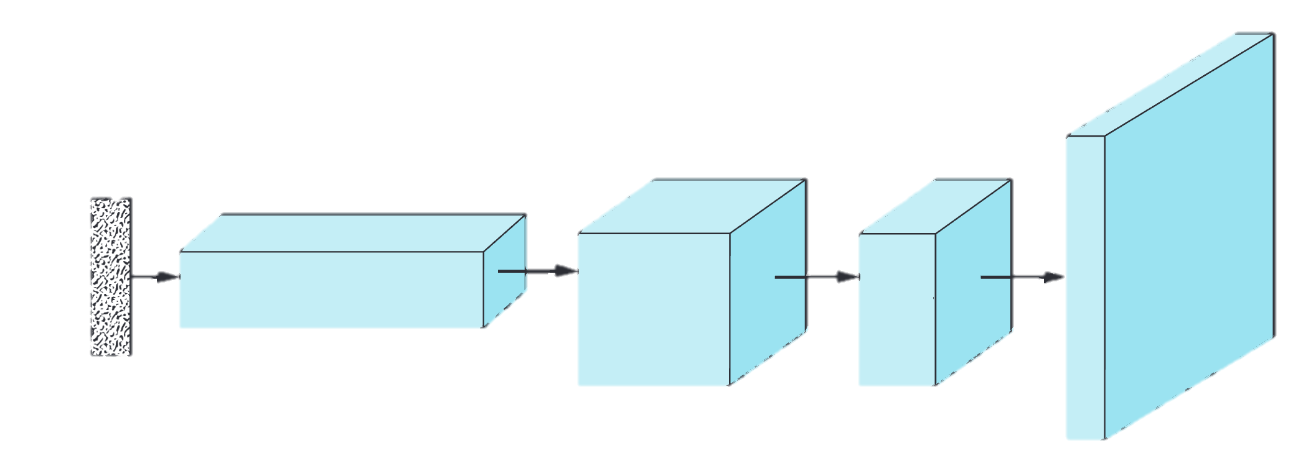
Generator
8
X
8
X
64
4x4x256
8x8x128
16x16x3

Slide 20
def create_generator() -> Sequential:
global NOISE_LENGTH
return Sequential(
[
Input((NOISE_LENGTH,)),
]
)

Slide 21
def create_generator() -> Sequential:
global NOISE_LENGTH
return Sequential(
[
Input((NOISE_LENGTH,)),
Dense(256 * 4 * 4),
LeakyReLU(0.01),
Reshape((4, 4, 256)),
]
)

Slide 22
def create_generator() -> Sequential:
global NOISE_LENGTH
return Sequential(
[
Input((NOISE_LENGTH,)),
Dense(256 * 4 * 4),
LeakyReLU(0.01),
Reshape((4, 4, 256)),
Conv2DTranspose(128, kernel_size=3, strides=1, padding="same"),
BatchNormalization(),
LeakyReLU(0.01),
]
)

Slide 23
def create_generator() -> Sequential:
global NOISE_LENGTH
return Sequential(
[
Input((NOISE_LENGTH,)),
Dense(256 * 4 * 4),
LeakyReLU(0.01),
Reshape((4, 4, 256)),
Conv2DTranspose(128, kernel_size=3, strides=1, padding="same"),
BatchNormalization(),
LeakyReLU(0.01),
Conv2DTranspose(64, kernel_size=3, strides=2, padding="same"),
BatchNormalization(),
LeakyReLU(0.01),
]
)

Slide 24
def create_generator() -> Sequential:
global NOISE_LENGTH
return Sequential(
[
Input((NOISE_LENGTH,)),
Dense(256 * 4 * 4),
LeakyReLU(0.01),
Reshape((4, 4, 256)),
Conv2DTranspose(128, kernel_size=3, strides=1, padding="same"),
BatchNormalization(),
LeakyReLU(0.01),
Conv2DTranspose(64, kernel_size=3, strides=2, padding="same"),
BatchNormalization(),
LeakyReLU(0.01),
Conv2DTranspose(
3, kernel_size=3, strides=2, padding="same", activation="tanh"
),
]
)

Slide 25
def create_generator() -> Sequential:
global NOISE_LENGTH
return Sequential(
[
Input((NOISE_LENGTH,)),
Dense(256 * 4 * 4),
LeakyReLU(0.01),
Reshape((4, 4, 256)),
Conv2DTranspose(128, kernel_size=3, strides=1, padding="same"),
BatchNormalization(),
LeakyReLU(0.01),
Conv2DTranspose(64, kernel_size=3, strides=2, padding="same"),
BatchNormalization(),
LeakyReLU(0.01),
Conv2DTranspose(
3, kernel_size=3, strides=2, padding="same", activation="tanh"
),
]
)

Slide 26
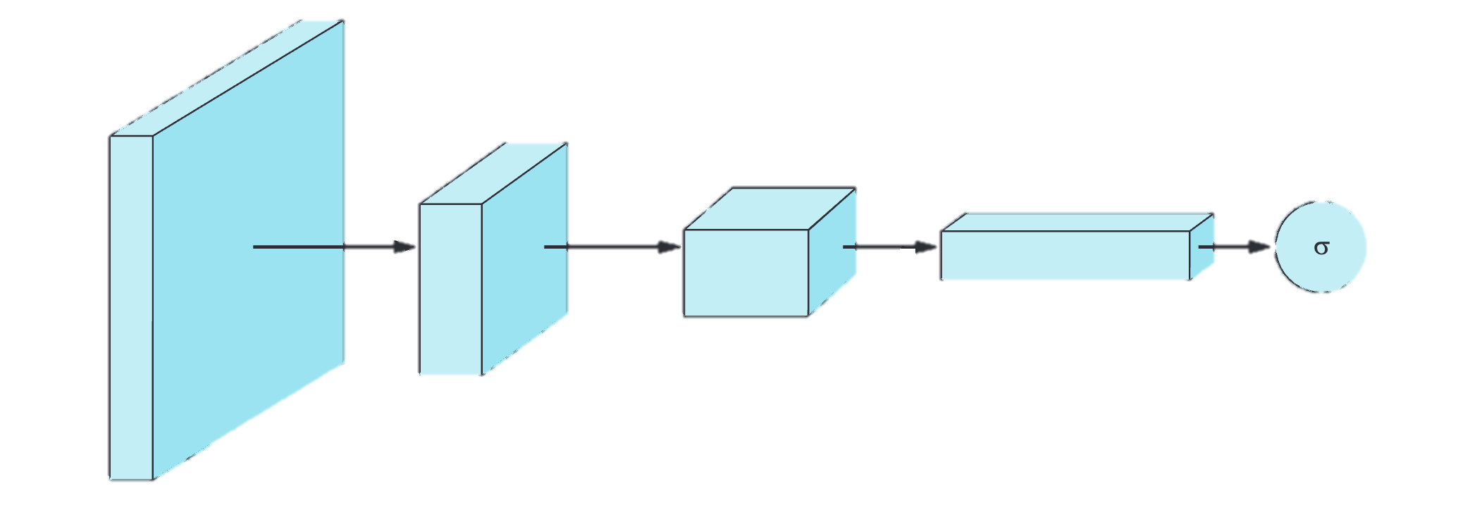
Discriminator
8
X
8
X
32
2x2x128
4x4x64
16x16x3

Slide 27
def create_discriminator() -> Sequential:
return Sequential(
[
Input(IMG_SHAPE),
]
)

Slide 28
def create_discriminator() -> Sequential:
return Sequential(
[
Input(IMG_SHAPE),
Conv2D(32, kernel_size=3, strides=2, padding="same"),
BatchNormalization(),
LeakyReLU(0.01),
]
)

Slide 29
def create_discriminator() -> Sequential:
return Sequential(
[
Input(IMG_SHAPE),
Conv2D(32, kernel_size=3, strides=2, padding="same"),
BatchNormalization(),
LeakyReLU(0.01),
Conv2D(64, kernel_size=3, strides=2, padding="same"),
BatchNormalization(),
LeakyReLU(0.01),
]
)

Slide 30
def create_discriminator() -> Sequential:
return Sequential(
[
Input(IMG_SHAPE),
Conv2D(32, kernel_size=3, strides=2, padding="same"),
BatchNormalization(),
LeakyReLU(0.01),
Conv2D(64, kernel_size=3, strides=2, padding="same"),
BatchNormalization(),
LeakyReLU(0.01),
Conv2D(128, kernel_size=3, strides=2, padding="same"),
BatchNormalization(),
LeakyReLU(0.01),
]
)

Slide 31
def create_discriminator() -> Sequential:
return Sequential(
[
Input(IMG_SHAPE),
Conv2D(32, kernel_size=3, strides=2, padding="same"),
BatchNormalization(),
LeakyReLU(0.01),
Conv2D(64, kernel_size=3, strides=2, padding="same"),
BatchNormalization(),
LeakyReLU(0.01),
Conv2D(128, kernel_size=3, strides=2, padding="same"),
BatchNormalization(),
LeakyReLU(0.01),
Flatten(),
Dense(1),
]
)

Slide 32
cross_entropy = BinaryCrossentropy(from_logits=True)
def discriminator_loss(real_output: list, fake_output: list) -> float:
global cross_entropy
real_loss = cross_entropy(tf.ones_like(real_output), real_output)
fake_loss = cross_entropy(tf.zeros_like(fake_output), fake_output)
total_loss = real_loss + fake_loss
return total_loss
def generator_loss(fake_output: list) -> float:
return cross_entropy(tf.ones_like(fake_output), fake_output)

Slide 33
cross_entropy = BinaryCrossentropy(from_logits=True)
def discriminator_loss(real_output: list, fake_output: list) -> float:
global cross_entropy
real_loss = cross_entropy(tf.ones_like(real_output), real_output)
fake_loss = cross_entropy(tf.zeros_like(fake_output), fake_output)
total_loss = real_loss + fake_loss
return total_loss
def generator_loss(fake_output: list) -> float:
return cross_entropy(tf.ones_like(fake_output), fake_output)

Slide 34
cross_entropy = BinaryCrossentropy(from_logits=True)
def discriminator_loss(real_output: list, fake_output: list) -> float:
global cross_entropy
real_loss = cross_entropy(tf.ones_like(real_output), real_output)
fake_loss = cross_entropy(tf.zeros_like(fake_output), fake_output)
total_loss = real_loss + fake_loss
return total_loss
def generator_loss(fake_output: list) -> float:
return cross_entropy(tf.ones_like(fake_output), fake_output)

Slide 35
generator_optimizer = Adam(learning_rate=LEARNING_RATE)
discriminator_optimizer = Adam(learning_rate=LEARNING_RATE)

Slide 36
generator_optimizer = Adam(learning_rate=LEARNING_RATE)
discriminator_optimizer = Adam(learning_rate=LEARNING_RATE)

Slide 37
generator_optimizer = Adam(learning_rate=LEARNING_RATE)
discriminator_optimizer = Adam(learning_rate=LEARNING_RATE)
@tf.function
def train_step(images: list, generator: Sequential, discriminator: Sequential) -> tuple[float, float]:
global BATCH_SIZE, NOISE_LENGTH, generator_optimizer, discriminator_optimizer
noise = tf.random.normal([BATCH_SIZE, NOISE_LENGTH])

Slide 38
generator_optimizer = Adam(learning_rate=LEARNING_RATE)
discriminator_optimizer = Adam(learning_rate=LEARNING_RATE)
@tf.function
def train_step(images: list, generator: Sequential, discriminator: Sequential) -> tuple[float, float]:
global BATCH_SIZE, NOISE_LENGTH, generator_optimizer, discriminator_optimizer
noise = tf.random.normal([BATCH_SIZE, NOISE_LENGTH])
with tf.GradientTape() as gen_tape, tf.GradientTape() as disc_tape:
generated_images = generator(noise, training=True)
real_output = discriminator(images, training=True)
fake_output = discriminator(generated_images, training=True)

Slide 39
@tf.function
def train_step(images: list, generator: Sequential, discriminator: Sequential) -> tuple[float, float]:
global BATCH_SIZE, NOISE_LENGTH, generator_optimizer, discriminator_optimizer
noise = tf.random.normal([BATCH_SIZE, NOISE_LENGTH])
with tf.GradientTape() as gen_tape, tf.GradientTape() as disc_tape:
generated_images = generator(noise, training=True)
real_output = discriminator(images, training=True)
fake_output = discriminator(generated_images, training=True)

Slide 40
@tf.function
def train_step(images: list, generator: Sequential, discriminator: Sequential) -> tuple[float, float]:
global BATCH_SIZE, NOISE_LENGTH, generator_optimizer, discriminator_optimizer
noise = tf.random.normal([BATCH_SIZE, NOISE_LENGTH])
with tf.GradientTape() as gen_tape, tf.GradientTape() as disc_tape:
generated_images = generator(noise, training=True)
real_output = discriminator(images, training=True)
fake_output = discriminator(generated_images, training=True)
gen_loss = generator_loss(fake_output)
disc_loss = discriminator_loss(real_output, fake_output)

Slide 41
@tf.function
def train_step(images: list, generator: Sequential, discriminator: Sequential) -> tuple[float, float]:
global BATCH_SIZE, NOISE_LENGTH, generator_optimizer, discriminator_optimizer
noise = tf.random.normal([BATCH_SIZE, NOISE_LENGTH])
with tf.GradientTape() as gen_tape, tf.GradientTape() as disc_tape:
generated_images = generator(noise, training=True)
real_output = discriminator(images, training=True)
fake_output = discriminator(generated_images, training=True)
gen_loss = generator_loss(fake_output)
disc_loss = discriminator_loss(real_output, fake_output)
gradients_of_generator = gen_tape.gradient(gen_loss, generator.trainable_variables)
gradients_of_discriminator = disc_tape.gradient(disc_loss, discriminator.trainable_variables)

Slide 42
@tf.function
def train_step(images: list, generator: Sequential, discriminator: Sequential) -> tuple[float, float]:
global BATCH_SIZE, NOISE_LENGTH, generator_optimizer, discriminator_optimizer
noise = tf.random.normal([BATCH_SIZE, NOISE_LENGTH])
with tf.GradientTape() as gen_tape, tf.GradientTape() as disc_tape:
generated_images = generator(noise, training=True)
real_output = discriminator(images, training=True)
fake_output = discriminator(generated_images, training=True)
gen_loss = generator_loss(fake_output)
disc_loss = discriminator_loss(real_output, fake_output)
gradients_of_generator = gen_tape.gradient(gen_loss, generator.trainable_variables)
gradients_of_discriminator = disc_tape.gradient(disc_loss, discriminator.trainable_variables)
generator_optimizer.apply_gradients(zip(gradients_of_generator, generator.trainable_variables))
discriminator_optimizer.apply_gradients(
zip(gradients_of_discriminator,discriminator.trainable_variables)
)
return gen_loss, disc_loss

Slide 43
def generate_and_save_images(epoch: int, generator: Sequential) -> None:
global NOISE_LENGTH, GRID_SIZE
noise = tf.random.normal([GRID_SIZE[0] * GRID_SIZE[1], NOISE_LENGTH])
predictions = generator(noise, training=False)

Slide 44
def generate_and_save_images(epoch: int, generator: Sequential) -> None:
global NOISE_LENGTH, GRID_SIZE
noise = tf.random.normal([GRID_SIZE[0] * GRID_SIZE[1], NOISE_LENGTH])
predictions = generator(noise, training=False)
fig, axes = plt.subplots(GRID_SIZE[0], GRID_SIZE[1], figsize=(16, 16))
plt.subplots_adjust(wspace=0.05, hspace=0.05)
for i, ax in enumerate(axes.flat):
image = (predictions[i, :, :, :] * 127.5 + 127.5).numpy().astype(np.uint8)
ax.imshow(image)
ax.axis("off")

Slide 45
def generate_and_save_images(epoch: int, generator: Sequential) -> None:
global NOISE_LENGTH, GRID_SIZE
noise = tf.random.normal([GRID_SIZE[0] * GRID_SIZE[1], NOISE_LENGTH])
predictions = generator(noise, training=False)
fig, axes = plt.subplots(GRID_SIZE[0], GRID_SIZE[1], figsize=(16, 16))
plt.subplots_adjust(wspace=0.05, hspace=0.05)
for i, ax in enumerate(axes.flat):
image = (predictions[i, :, :, :] * 127.5 + 127.5).numpy().astype(np.uint8)
ax.imshow(image)
ax.axis("off")
plt.savefig(
f"{path_run}/epoch_{epoch:02d}.png",
bbox_inches="tight",
pad_inches=0,
)
plt.close(fig)

Slide 46
def train(dataset, epochs: int = EPOCHS) -> tuple[Sequential, Sequential, dict, dict]:
generator = create_generator()
discriminator = create_discriminator()

Slide 47
def train(dataset, epochs: int = EPOCHS) -> tuple[Sequential, Sequential, dict, dict]:
generator = create_generator()
discriminator = create_discriminator()
generator_losses = []
discriminator_losses = []

Slide 48
def train(dataset, epochs: int = EPOCHS) -> tuple[Sequential, Sequential, dict, dict]:
generator = create_generator()
discriminator = create_discriminator()
generator_losses = []
discriminator_losses = []
for epoch in tqdm(range(epochs)):
for image_batch in dataset:
generator_loss, discriminator_loss = train_step(image_batch, generator, discriminator)
generator_losses.append(generator_loss)
discriminator_losses.append(discriminator_loss)

Slide 49
def train(dataset, epochs: int = EPOCHS) -> tuple[Sequential, Sequential, dict, dict]:
generator = create_generator()
discriminator = create_discriminator()
generator_losses = []
discriminator_losses = []
for epoch in tqdm(range(epochs)):
for image_batch in dataset:
generator_loss, discriminator_loss = train_step(image_batch, generator, discriminator)
generator_losses.append(generator_loss)
discriminator_losses.append(discriminator_loss)
generate_and_save_images(epoch + 1, generator)
return generator, discriminator, generator_losses, discriminator_losses

Slide 50
def plot_losses(
generator_losses: list[float], disc_losses: list[float]
) -> None:
plt.figure(figsize=(10, 6))
plt.plot(gen_means, label="Generator")
plt.plot(disc_means, label="Discriminator")
plt.xlabel("Epoch")
plt.ylabel("Average Loss")
plt.legend()
plt.title("Average Loss per Epoch")
plt.show()

Slide 51
def create_gif(
directory: str = path_run, output_file: str =f"{path_run}/output.gif“
) -> None:
files = sorted(os.listdir(directory))
images = []
for filename in files:
if filename.endswith(".png"):
img = imageio.v2.imread(os.path.join(directory, filename))
images.append(img)
imageio.mimsave(output_file, images, duration=1)
create_gif()

Slide 52
generator, discriminator, generator_losses, discriminator_losses = train(train_dataset)

Slide 53
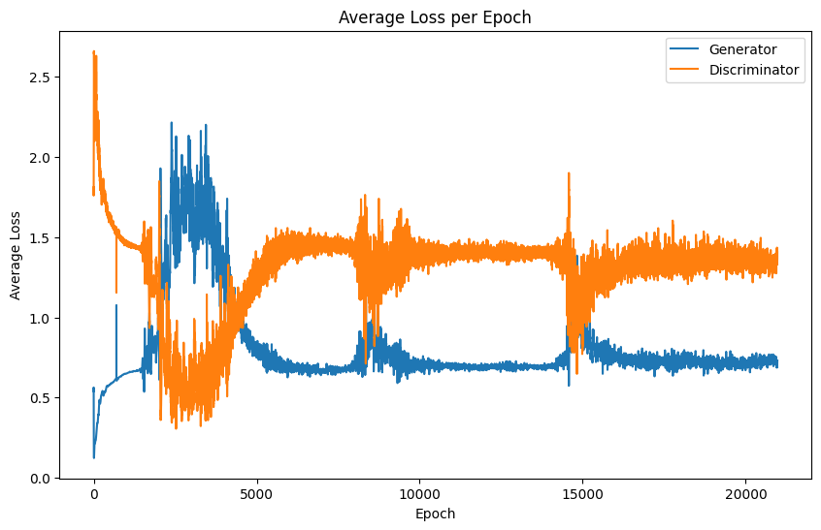
plot_losses(generator_losses, discriminator_losses)

Slide 54
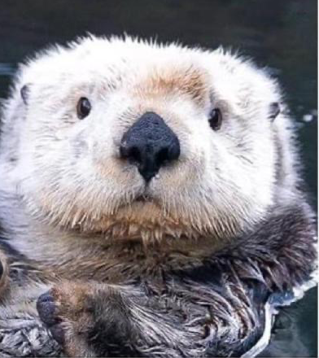

Questions?
￼
github.com/RomanGoEmpire/thd-ki-seminar-dc-gans

